Slide 1


PostgreSQL
Session – 3
SQL | DDL, DQL, DML, DCL and TCL

Slide 2
Introduction
Structured Query Language(SQL)
These SQL commands are mainly categorized into five categories:
DDL – Data Definition Language
DQL – Data Query Language
DML – Data Manipulation Language
DCL – Data Control Language
TCL – Transaction Control Language

Slide 3
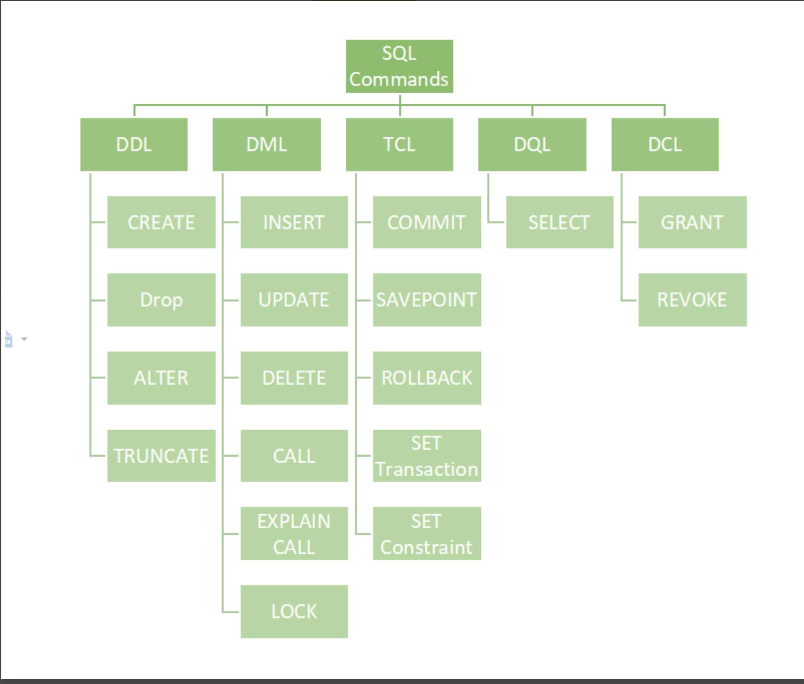

Slide 4
DML(Data Manipulation Language)
The SQL commands that deal with the manipulation of data present in the database belong to DML or Data Manipulation Language and this includes most of the SQL statements. It is the component of the SQL statement that controls access to data and to the database. Basically, DCL statements are grouped with DML statements.
List of DML commands:
INSERT: It is used to insert data into a table.
UPDATE: It is used to update existing data within a table.
DELETE: It is used to delete records from a database table.
LOCK: Table control concurrency.
CALL: Call a PL/SQL or JAVA subprogram.
EXPLAIN PLAN: It describes the access path to data.

Slide 5
SQL | DELETE Statement
Existing records in a table can be deleted using the SQL DELETE Statement. We can delete a single record or multiple records depending on the condition we specify in the WHERE clause.
Deleting Single Record
Query:
Delete the rows where NAME = ‘Rithvik’. This will delete only the fourth row.
Delete All of the Records
Query:
DELETE FROM GFG_EMPLOyees; Or DELETE * FROM GFG_EMPLOyees;
Important Note: DELETE is a DML (Data Manipulation Language) command hence operation performed by DELETE can be rolled back or undone.

Slide 6
SQL | UPDATE Statement
The UPDATE statement in SQL is used to update the data of an existing table in the database. We can update single columns as well as multiple columns using the UPDATE statement as per our requirement.
Syntax
UPDATE table_name SET column1 = value1, column2 = value2,… UPDATE:
WHERE condition;
table_name: name of the table
column1: name of first , second, third column….
value1: new value for first, second, third column….
condition: condition to select the rows for which the
values of columns needs to be updated.
Parameter Explanation
Command is used to update the column value in the table.
WHERE: Specifies the condition which we want to implement on the table

Slide 7
SQL | UPDATE Statement Cont..
Update Single Column
Query
UPDATE Customer SET CustomerName = 'Nitin' WHERE Age = 22;
Updating Multiple Columns
Query
Update the columns NAME to ‘Satyam’ and Country to ‘USA’ where CustomerID is 1.
Updating Multiple Columns
Query
UPDATE Customer SET CustomerName = 'Satyam', Country = 'USA' WHERE CustomerID = 1;
Omitting WHERE Clause
If we omit the WHERE clause from the update query then all of the rows will get updated.
Query
UPDATE Customer SET CustomerName = 'Shubham'

Slide 8
SQL Operators | BETWEEN & IN Operator
Operators are the foundation of any programming language. We can define operators as symbols that help us to perform specific mathematical and logical computations on operands. In other words, we can say that an operator operates the operands.
Between Operator
The SQL BETWEEN condition allows you to easily test if an expression is within a range of values (inclusive). The values can be text, date, or numbers. It can be used in a SELECT, INSERT, UPDATE, or DELETE statement. The SQL BETWEEN Condition will return the records where the expression is within the range of value1 and value2.
Syntax:
SELECT column_name(s) FROM table_name WHERE column_name BETWEEN value1 AND value2;
Using BETWEEN with Numeric Values
SELECT column_name(s)FROM table_nameWHERE column_name BETWEEN value1 AND value2;
Using the NOT Operator with BETWEEN
Find all the Employee names whose salary is not in the range of 30000 and 45000.
SELECT Name FROM Emp WHERE Salary NOT BETWEEN 30000 AND 45000;

Slide 9
SQL Operators | IN Operator
IN operator allows you to easily test if the expression matches any value in the list of values. It is used to remove the need for multiple OR conditions in SELECT, INSERT, UPDATE, or DELETE. You can also use NOT IN to exclude the rows in your list. We should note that any kind of duplicate entry will be retained.
Syntax:
SELECT column_name(s)FROM table_name WHERE column_name IN (list_of_values);
Find the Fname, and Lname of the Employees who have a Salary equal to 30000, 40000, or 25000.
Query:
SELECT Name FROM Emp WHERE Salary IN (30000, 40000, 25000);
Find the Fname and Lname of all the Employees who has a Salary not equal to 25000 or 30000.
Query:
SELECT Name FROM Emp WHERE Salary NOT IN (25000, 30000);

Slide 10
SQL Operators | LIKE operator
The PostgreSQL LIKE operator is used query data using pattern matching techniques. Its result include strings that are case-sensitive and follow the mentioned pattern. It is important to know that PostgreSQL provides with 2 special wildcard characters for the purpose of patterns matching as below:
Percent ( %) for matching any sequence of characters.
Underscore ( _) for matching any single character.
Syntax: string LIKE pattern;
SELECT first_name,last_name FROM customer WHERE first_name LIKE 'K%’;
Here we will query for customers whose first name begins with any single character, is followed by the literal string “her”, and ends with any number of characters using the LIKE operator in our sample database
SELECT first_name, last_name FROM customer WHERE first_name LIKE '_her%';

Slide 11
string NOT LIKE pattern;
SQL Operators | NOT LIKE operator
The PostgreSQL NOT LIKE works exactly opposite to that of the LIKE operator. It is used to data using pattern matching techniques that explicitly excludes the mentioned pattern from the query result set.Its result include strings that are case-sensitive and doesn’t follow the mentioned pattern. It is important to know that PostgreSQL provides with 2 special wildcard characters for the purpose of patterns matching as below:
Percent ( % ) for matching any sequence of characters.
Underscore ( _ ) for matching any single character.
Syntax: string NOT LIKE pattern;
Here we will make a query to find the customer in the “customer” table by looking at the “first_name” column to see if there is any value that doesn’t begin with “K” using the NOT LIKE operator in our sample database.
SELECT first_name,last_name FROM customer WHERE first_name Not LIKE 'K%’;
Here we will query for customers whose first name begins with any single character, is followed by the literal string “her”, and ends with any number of characters using the LIKE operator in our sample database
SELECT first_name, last_name FROM customer WHERE first_name not LIKE '_her%';

Slide 12
IF Statement
PostgreSQL has an IF statement executes `statements` if a condition is true. If the condition evaluates to false, the control is passed to the next statement after the END IF part.
Syntax:
IF condition THEN
statements;
END IF;
In this example, we declare two variables a and b. In the body of the block, we compare the value of a and b using the comparison operator >, < and = in the boolean expressions of the IF statements.
DO $$
DECLARE
a integer := 10;
b integer := 20;
BEGIN
IF a > b THEN
RAISE NOTICE 'a is greater than b';

Slide 13
IF STATEMENT Cont...
END IF;
IF a < b THEN
RAISE NOTICE 'a is less than b';
END IF;
IF a = b THEN
RAISE NOTICE 'a is equal to b';
END IF;
END $$;

Slide 14
EXISTS Operator
In PostgreSQL, the EXISTS operator is used to test for the existence of rows in a subquery.It is generally used with correlated subqueries. If the subquery returns at least one row, the result of EXISTS is true. In case the subquery returns no row, the result is of EXISTS is false.
Syntax: EXISTS (subquery)
Example 1: Here we will query for customers who have at least one payment whose amount is greater than 9 USD using the “customer” and “payment” tables of our sample database.
SELECT first_name, last_nameFROM customer c WHERE EXISTS
(SELECT 1 FROM payment p WHERE p.customer_id = c.customer_id AND amount > 9 ) ORDER BY first_name, last_name;
Example 2: Here we will query for films that are not available in the inventory using the “film” and “inventory” tables of our sample database
SELECT title
FROM film f
WHERE NOT EXISTS
(SELECT 1
FROM inventory i
WHERE f.film_id = i.film_id )
ORDER BY title;

